Slide 1

Nairobi Education Insights
Analysis presentation.
AUTHOR – CHRISTINE KIRIMI

Slide 2
OVERVIEW
Sustainable development goal 4, is a commitment to ensure inclusive and equitable quality education and promote lifelong learning opportunities for all.
ASSUMPTIONS
Sub-counties in the Census dataset were assumed to be similar to the constituencies in Education Facilities Dataset
It was assumed that the higher the general population per area also the higher the student population in the area.
The Problem
The Objective
2019 Census Data
Education Facilities Dataset
The objective is to analyze the most significant gaps in the current education infrastructure and propose actionable recommendation for improvement and make good use of the recently secured grant

Slide 3
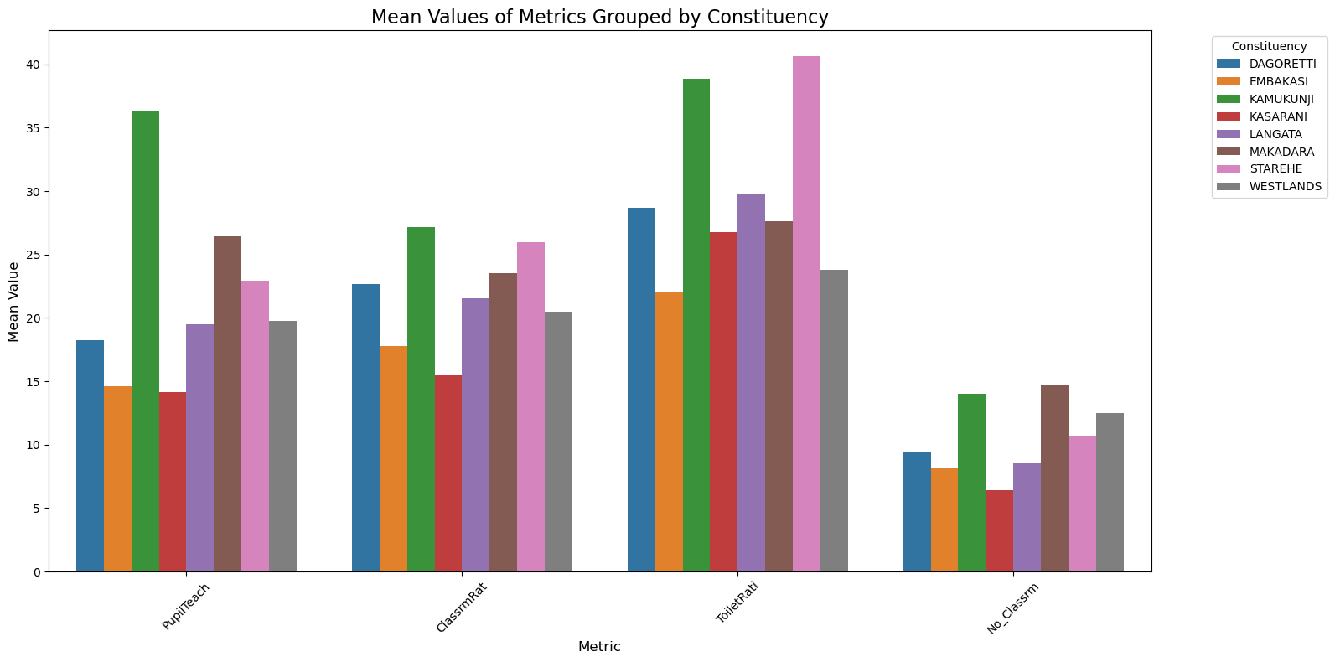
The Distribution of key Education Infrastructure per Constituency.
People teacher ratio are higher in areas such as Kamukunji and Makadara
Classroom ratio are higher in kamukunji Starehe and Makadara
Toilet student ratio are higher in starehe then Kamukunji

Slide 4
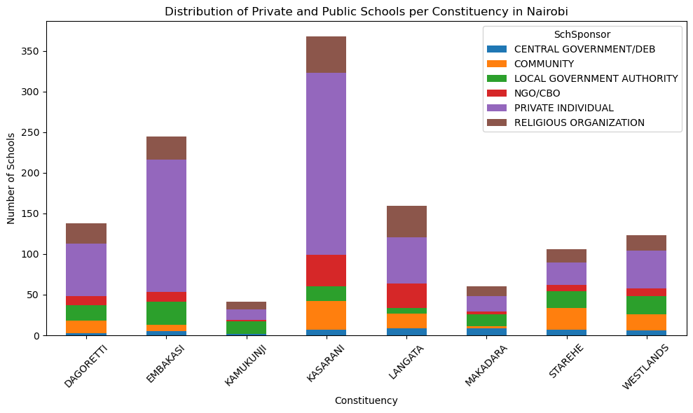
Distribution of School Sponsors per Constituency
Type of Sponsor
From the graph we can see that most of the schools are privately owned with a few schools owned by the government or community

Slide 5
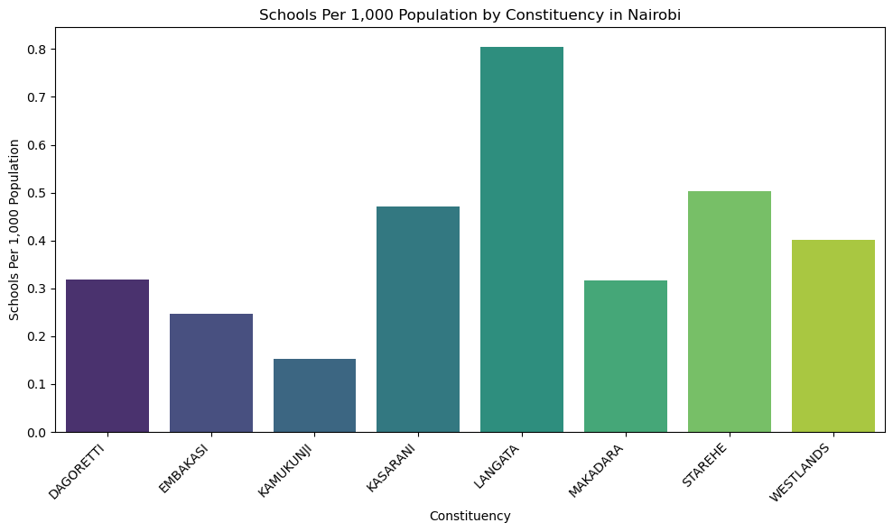
School Distribution in Relation to Population
From the graph we can see that Langata and Kasarani have a higher school distribution to their population.
Kamukunji and Makadara have a low school distribution for their population

Slide 6
CONCLUSION
RECOMMENDATIONS
Pupil Teacher Ratio are higher in areas such as Kamukunji followed by Makadara and Starehe
Classroom to students ratio are higher in starehe, Kamukunji and Makadara
Toilet to students ratio are higher in Starehe then Kamukunji
We have more students not having enough classrooms in Makadara and Kamukunji
I Recommend that the government should construct more schools especially in Kamukunji and Makadara which have a higher population compared to the rest of Nairobi
More teachers should be hired in schools especially Kamukunji , Makadara and Starehe
Building of Amenities and Classrooms should also take place in the same areas Kamukunji,Starehe and Makadara
In the data it is evident that Kamukunji, Makadara and Starehe constituencies are lagging behind as compared to other constituencies in Nairobi in terms of Infrastructure development in Schools and Also teacher distribution
Leverage community and NGO support for ongoing improvements.
I

Slide 7
THANK YOU !

